Slide 1
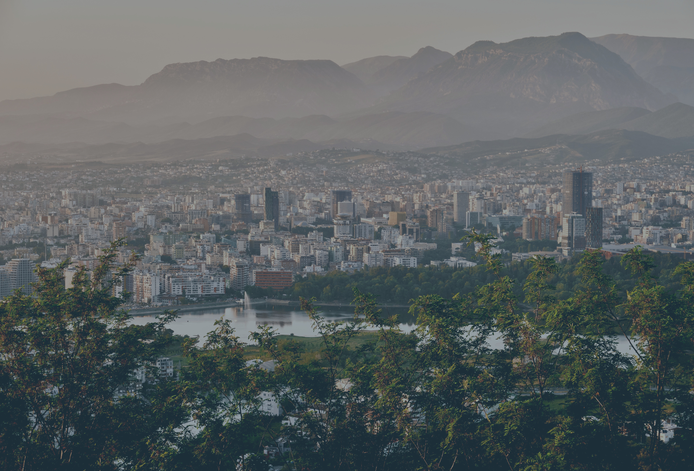


Citizens Budget Execution
20
25
Report
A look at the public finances of 2025

Slide 2

2
Citizens Budget Execution Report 2025
This report is based on the draft law package for the Budget Execution of 2025. It presents a summarised and simplified version of this package, dedicated to the general public.
Use of text
The use of the text and data presented in this report is permitted, provided that they are used unchanged and with citation of the source:
Source: Ministry of Finance
Text modification
If the text, data or graphics presented in this report are used to generate different material or data, the following citation is preferred: Based on data from the Ministry of Finance
Additional information
The draft law package of the Budget Execution for 2025 and the relevant tables are published on the website of the Ministry of Finance:
www.financa.gov.al
For further information or clarification, you can contact the following address:
General Directorate of Budget Management, General Directorate of Budget,
Ministry of Finance,
Bulevardi “Dëshmorët e Kombit“, Tiranë.
email:info@financa.gov.al
This report was published by the Ministry of Finance
May 2026

Slide 3
Table of content
KEY BUDGET TERMS EXPLAINED | 4
LIST OF ACRONYMS | 5
MESSAGE FOR THE READER | 6
POPULATION AND EMPLOYMENT | 7
KEY FISCAL INDICATORS | 8
PUBLIC DEBT | 9
REVENUES | 10
EXPENDITURE | 12
BUDGET REVISIONS | 14
Education | 16
Health | 17
Social Protection | 18
Housing | 19
Economic Affairs | 20
Defence | 23
Public Order and Safety | 24
Environmental Protection | 25
Recreation, Culture and Religion | 26
LOCAL BUDGET | 27
REFORMS IN PUBLIC FINANCE MANAGEMENT | 29

Slide 4
4
Citizens Budget Execution Report 2025
MBROJTJA
KEY BUDGET TERMS EXPLAINED
2% e PBB
Revenue is money the government collects, mostly from taxes, but also from fees, fines, and profits from government-owned companies.
Expenditure is money the government spends to provide services to its citizens.
Budget is a plan for how the government will collect and spend money and finance a deficit over one year. It comprises the total of revenues, expenditures and financing of the central and local governments and special funds, which are approved by law by the Assembly of Albania or by decision of the council of the local government unit.
General government budget is the sum of the central and local budget (adjusted for transfers from the central to the local budget)
Central government budget includes all revenues, expenditures and financing of the central government – including the special funds.
Local government budget includes all revenues, expenditures and financing of the local government units (municipalities)
Debt is the total amount of money the government owes to its financiers, usually from borrowing to cover past deficits.
Deficit in a budget year is the difference between revenue and expenditure, when expenditure is greater than revenue.
Surplus in a budget year is the difference between revenue and expenditure, when revenue is greater than expenditure.
Fiscal Policy is the government’s plan about how to collect and spend money to help the economy. It includes decisions about taxes, spending, and borrowing.
Gross Domestic Product (GDP) is the total value of all goods and services a country produces in a year. It’s a way to measure how big and healthy the economy is.
Inflation is the general rise in prices over time, which means money buys less than it did before.
Interest is the cost of borrowing money.
Arrears are unpaid bills that are overdue.
Budget revision is the change in the annual budget law during the year.
Primary Balance is the difference between what the government collects and spends, not counting interest payments on debt.
Budget execution rate shows what percentage of the budget has been actually achieved by the end of the reporting period.

Slide 5
5
Citizens Budget Execution Report 2025
LIST OF ACRONYMS:
MF: Ministry of Finance
MoI: Ministry of Interior
MD: Ministry of Defense
MIE: Ministry of Infrastructure and Energy
MTCS: Ministry of Tourism, Culture and Sports
AKSHI: National Agency of Information Society
ADF: Albanian Development Fund
IEVP: Institution for Enforcement of Criminal Court Decisions
IKMT: National Inspectorate for Territorial Protection
ISUV: Institute of Food Safety and Veterinary
GDP: Gross Domestic Product
MTRS: Medium- Term Revenue Strategy
PIT: Personal Income Tax
VAT: Value Added Tax
AI: Artificial Intelligence

Slide 6
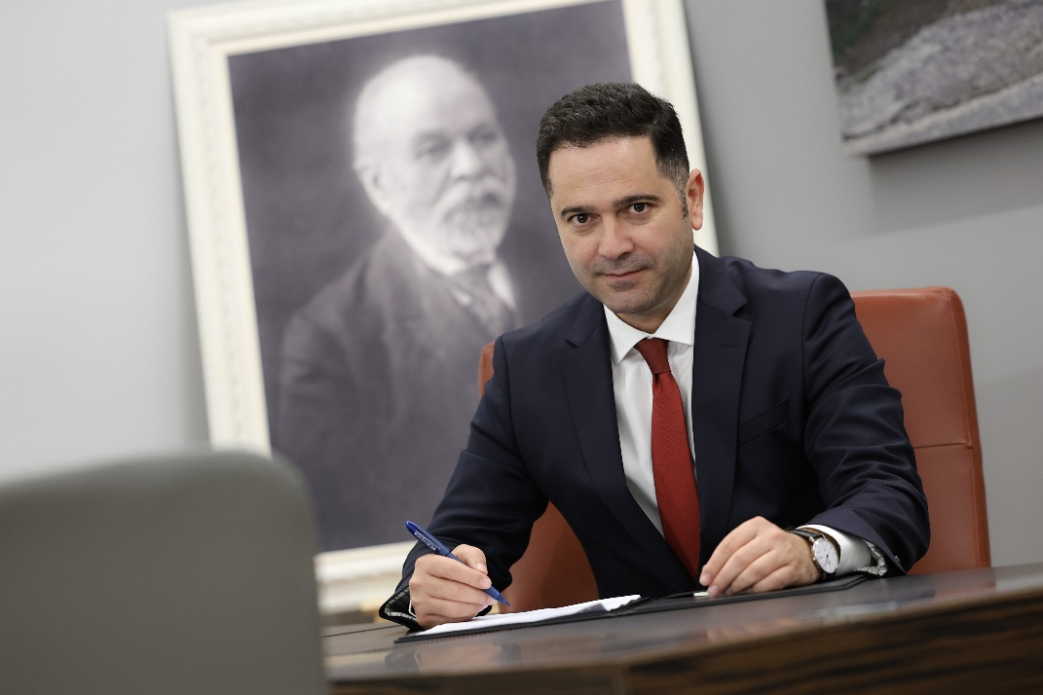
6
Citizens Budget Execution Report 2025
Message for the reader
Dear citizens,
I have the pleasure of presenting the Citizens Budget Execution Report 2025.
A document dedicated to you.
This report includes data on revenues collected from taxes and other sources, but also on how the money is spent, turned into investments and priorities, for the benefit of the economy.
Our objective is to provide simplified, understandable information to all on the key reforms carried out to enhance the management of public money, and all this as part of our journey towards integration into the European Union.
This report is part of our ongoing commitment to be transparent, accountable, and open with you. We believe that every citizen has the right to know how public funds are used effectively to ensure a better future for our country.
Minister of Finance
Petrit MALAJ
Falëminderit

Slide 7

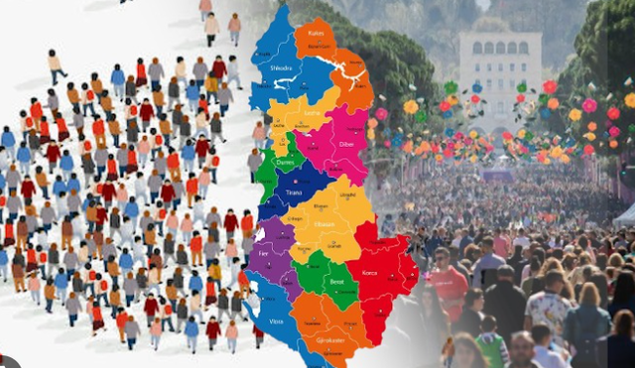
7
Citizens Budget Execution Report 2025
POPULATION AND EMPLOYMENT
Key population and employment data is collected and published by INSTAT. The 2023 Population and Housing Census counted 2.4 million inhabitants within the borders of Albania, which is 420 thousand people less than the 2011 Census. Employment rate and real average monthly salary have increased over time.
Shpenzimet e planifikuara:
7.0 miliardë LEK
shpenzime aktuale
8.0 miliardë LEK
Total population: 2.4 million
Life expectancy
49.6%
50.4%
77.3 years
80.9 years
INSTAT, population census 2023
INSTAT, 2023
shkalla e ekzekutimit të buxhetit
110.3%
rritje në krahasim me vitin 2023
x%
Average gross monthly salary:
84.100 LEK
Employment rate population aged 15-64: 69.3%
INSTAT, 2025
76%
62.7%
shpenzime aktuale
0.3% e PBB-së
Unemployment rate
8.4%
INSTAT, T4 2025
INSTAT, T4 2025

Slide 8
8
Citizens Budget Execution Report 2025
KEY FISCAL INDICATORS
Gross Domestic Product (GDP)
2.651 billion LEK
GDP per capita
1.121.730 LEK
Economic growth
3.8%
Public Debt
52.9% of GDP
Inflation
2.2%
Revenues
28.5% of GDP
Expenditure
30.2% of GDP
Deficit
1.8% of GDP
Economic Growth The Albanian economy kept growing in 2025. The country’s total economic product (GDP) grew by 3.8%, thanks to a strong tourism season and more people spending money at home. The services and construction sectors were the biggest contributors to this growth. Public Debt Albania is working to gradually reduce its public debt, which stood at 52.9% of GDP in 2025. The government is committed to keeping debt under control and following the rules set out in the Organic Budget Law, which promotes responsible financial management for long-term stability. | Fiscal Policy The government continued to focus on keeping the budget healthy and stable. This means spending wisely and making sure the country doesn’t borrow too much. In 2025, Albania’s finances had a positive trend: the government collected 6.2% more revenue than the year before, while spending increased by 10%. Budget Deficit The government reduced its budget deficit to 1.8% of GDP, which is better than expected. Over the next few years, the goal is to keep the average deficit around 2%, following the “golden rule” — which means borrowing only for investments, not for everyday spending.
Inflation and interest rates Prices rose more slowly in 2025, with inflation staying just below the 3% target. To support this trend, the Bank of Albania cut interest rates twice, from 2.75% to 2.5%, to help keep inflation on track and support the economy.
General Government Budget
Billion LEK | Original Budget | Revised Budget AN11/2025 | Actual Execution | Execution rate % (against original budget) | Execution rate % (against revised budget)
Total revenue | 757 | 770.1 | 754.6 | 99.7% | 98.0%
Total expenditure | 825.1 | 831.8 | 801.7 | 97.2% | 96.4%
Deficit | 68.1 | 61.6 | 47.1 | 69.2% | 76.5%

Slide 9

9
Citizens Budget Execution Report 2025
PUBLIC DEBT
Gross Public Debt 2025:
1,401.5 billion LEK
Gross Public Debt 2024:
54.2% of GDP
Gross Public Debt 2025:
52.9% of GDP
Total interest payments 2025:
54.7 billion LEK
Budget execution rate interest:
89%
Interest as percentage of total expenditure:
6.8%
During 2025, interest payments on government debt amounted to 54.7 billion LEK. At the end of 2025, the Government's debt stock, including local government debt, reached 1,401.5 billion LEK. The debt-to-GDP ratio decreased from 54.2% at the end of 2024 to 52.9% at the end of 2025, marking a decrease of 1.3 percentage point.
Interest payments (billion LEK)
Debt Stock (billion LEK)

Slide 10

10
Citizens Budget Execution Report 2025
REVENUE
Planned revenue:
757 billion LEK
Actual revenue:
755 billion LEK
or 28.5% of GDP
Execution rate:
99.7%
Increase compared to 2024:
6.2%
Total general government revenues amounted to 754.6 billion LEK, or about 28.5% of GDP. Actual revenues were collected at 99.7% of the original plan. National and local taxes contribute to 71% of general government revenues. Other revenues include contributions to special funds, such as the health and social insurance fund, grants from international partners, and non-tax revenue, such as fees paid by citizens for certain services provided by the government.
General Government Revenue ( in billion LEK)

Slide 11

11
Citizens Budget Execution Report 2025
REVENUE
General Government Revenue (billion LEK)
The following events had a positive impact on the revenue collection: Net domestic VAT increased due to the expansion of activity and the implementation of the measures foreseen in the MTRS, on good tax administration and increasing voluntary compliance. Revenues from PIT increased mainly due to the implementation of MTRS measures for declaration of the actual wage, expansion of formalization in the labor market and increased employment. Social security and health contributions had a positive progress due to the increase of the salaries in the public and private sector, expansion of the contributors’ base as well as the MTRS measures on reduction of informality and strengthening the collection of the contributions. Revenues from excise duties increased mainly due to the higher consumption of fuels, cigarettes and coffee. | In contrast some developments had a negative impact on the government revenues: VAT performance on imports was significantly influenced by the strength of LEK and the negative impact of the exchange rate. The profit tax did not reach the planned target due to the decline of the manufacturing sector performance. Mining rent collection is down compared to 2024 due to lower international prices and less mineral exports.

Slide 12
12
Citizens Budget Execution Report 2025
EXPENDITURE
Planned expenditure:
825.1 billion LEK
Actual expenditure:
801.7 billion LEK
ose 30.2% of GDP
Budget execution rate:
97.2%
Increase as compared to 2024:
10%
Total general government expenditures amounted to 801.7 billion LEK, which is equivalent to 30.2% of GDP.
Actual expenditures reached 97.2% of the annual plan.
The key areas of expenditure are in special funds such as social security funds, health funds and compensation of former owners, of about 41.4% of current expenditures and 33.7% of total budget expenditures.
Other expenditures include those on personnel, subsidies, interests on loans, operations and maintenance expenditures, social expenditure (e.g. unemployment benefit, economic assistance, compensation for the politically persecuted and the baby bonus), local government budget and capital expenditure.
Capital expenditures for 2025 (including the Reconstruction Fund) amounted to approximately ALL 131.6 billion. Compared with 2024, this represents an increase of 13.4%, equivalent to approximately ALL 15.6 billion.
Expenditures of the General Government (billion LEK)
Current Expenditures of the General Government (billion LEK)

Slide 13

13
Citizens Budget Execution Report 2025
EXPENDITURE
Expenditures of the General Government by function (billion LEK)

Slide 14
14
Citizens Budget Execution Report 2025
BUDGET REVISIONS
During 2025, the state budget was amended by 4 normative acts:
Billion LEK | Original budget | 1st revision (AN3/ 2025) | 2nd revision (AN6/ 2025) | 3rd revision (AN10/ 2025) | 4th revision (AN11/ 2025) | Actual | Budget execut. rate % (against original budget)
Total revenue | 757.0 | 758.0 | 758.0 | 770.1 | 770.1 | 754.6 | 99.7%
Total expenditure | 825.1 | 826.1 | 826.1 | 831.8 | 831.8 | 801.7 | 97.2%
Deficit | 68.1 | 68.1 | 68.1 | 61.6 | 61.6 | 47.1 | 69.2%
1
Normative act no. 3 dated 29.04.2025
Allocation of 1 billion LEK of the Government in the start-up “Machine Thinking Lab”.
Normative act no. 6 dated 11.06.2025, inter alia:
No amendments to the total revenue and expenditure, but only reallocations between items of neutral effect.
Allocation of 3.0 billion LEK to a new agriculture Sovereign Scheme
Allocation of 3.3 billion LEK to purchase AI technology products in the field of cybersecurity.
Additional allocation of 1.5 billion LEK for new development projects under ADF.
Additional allocation of 318 million LEK for the Sports Programme.
Normative act no.10 dated 08.10.2025, inter alia:
Reallocation of funds to the government functional units due to the reorganization of the government cabinet after the general elections of 11th of May 2025.
Increase of general revenue by 12.1 billion LEK.
Increase of general expenditure by 5.7 billion LEK.
Additional allocation of 7.6 billion LEK for the Pensions’ Scheme, of which 5.9 billion allocation to the end-of-year bonus.
Additional allocation of about 6 billion LEK to accelerate the MIE infrastructure projects.
Additional allocation of 2.8 billion LEK on the IT system and Oracle projects, Microsoft services, AI platforms, IT network maintenance of the budget institutions etc.
Additional allocation of 1.1 billion LEK to fund the needs of the State Police, Republican Guard, Civil Status Offices and Prefectures.
Allocation of 556 million LEK to the Albanian Intelligence Service to purchase IT systems and software.
2
3

Slide 15
15
Citizens Budget Execution Report 2025
BUDGET REVISIONS
Normative act no. 11 dated 19.12.2025, inter alia:
No amendments to the total revenue and expenditure, but only reallocations between items of neutral effect.
Additional expenditure for Financial support for 148,000 beneficiaries of the social categories of Economic Assistance and Disability: 2.23 billion LEK.
Additional allocation for MIE to advance the works in the high-performance projects: 10 billion LEK.
Increase of the Farmers’ Scheme: 2.3 billion LEK.
Additional allocation for MIE for roads’ maintenance, expropriations etc.: 1.6 billion LEK.
Additional allocation for the State Police, for food compensation, overtime/per diem, and fuel due to the intensive tourist season and payments arising from court decisions on IKMT: 1.3 billion LEK
Additional allocation for the Ministry of Finance to fund the initial capital of the Albanian Development Bank: 1 billion LEK.
Additional allocation for the MTCS to organize national and international sports activities: 847 million LEK
Allocation for the Ministry of Defence to cover the financial obligations owned to NATO and the military missions abroad: 626 million LEK.
Determined the transfer of all unused funds at the close of the 2025 budget, to the pensioners' support account at the Bank of Albania, which is used only by Decision of the Council of Ministers.
4

Slide 16

16
Citizens Budget Execution Report 2025
EDUCATION
Planned expenditure:
85.2 billion LEK
Actual expenditure :
83.9 billion LEK
or 3.2% of GDP
Budget execution rate:
98.6%
Increase as compared to 2024:
10.3%
Key achievements: Education has been provided to 213,520 thousand girls and boys in the 9-year public education system, and 60,027 girls and boys enrolled in the public high schools. 35,000 girls and boys who live over 2 km from the school, as well as 12,000 teachers who work over 5 km from their home benefited from the transportation service All students from first grade to ninth grade benefited from free textbooks and around 13,000 students from socially disadvantaged groups benefited from free textbooks in secondary education 11,000 higher education students benefited from scholarships and financial support for accommodation in student dormitories. | Schools and secondary education institutions have been constructed and rehabilitated across several municipalities, including Berat, Memaliaj, Elbasan, Përmet, Has, Kukës, and Pogradec, contributing to the enhancement of educational infrastructure nationwide. Rehabilitation and capacity expansion works were completed in primary schools in Finiq, Gramsh, and Tropojë, while reconstruction projects were carried out at the ‘Skënderbeu’ secondary school in Has and the ‘Avni Rustemi’ school in Kukës, contributing to the modernization of educational facilities. Educational equipment and supporting infrastructure were provided to strengthen the learning environment, including the furnishing of schools and the supply of laboratory equipment for general secondary education.

Slide 17

17
Citizens Budget Execution Report
HEALTH
Planned expenditure:
76.2 billion LEK
Actual expenditure:
76.6 billion LEK
or 2.9% of GDP
Budget execution rate:
100.6%
Increase as compared to 2024:
9.9%
Key achievements: 7.3 million visits were conducted in the health centres were recorded and 331 thousand patients were hospitalized and treated and over 143 thousand citizens were treated in emergency medical units. 378 thousand patients were treated with a reimbursed prescription by their family doctor. 61 thousand citizens aged 35 - 70 years old received basic health check-ups. About 1,444 patients were treated in psychiatric hospitals. 200 thousand children aged 0-18 were vaccinated and 224 thousand citizens were vaccinated with the seasonal flu vaccine. More than 5 million laboratory examinations were performed. 127 couples underwent medically assisted reproduction in the institutions of public health. | The reconstruction of the existing Neonatology and Obstetrics building, the construction of two new buildings at Obstetric-Gynaecological University Hospital "Queen Geraldine", as well as the reconstruction of the housing units at the Vlora Psychiatric Hospital, has been completed. Projects supported by the World Bank for the improvement of the healthcare system have been completed, including interventions at the hospitals of Krujë and Lezhë, as well as in the Cardiac Surgery and Psychiatry units at the University Hospital Center of Tirana (QSUT).

Slide 18


18
Citizens Budget Execution Report 2025
SOCIAL PROTECTION
Planned expenditure:
240.2 billion LEK
Actual expenditure:
240.9 billion LEK
or 9.1% of GDP
Budget execution rate:
100.3%
Increase as compared to 2024:
6.3%
Key achievements: 95,784 persons and caretakers benefited from the disability programme. 50,631 families and vulnerable persons benefited financial support under the Economic Support Scheme. 242 persons benefited from social care services provided in public residential centres. 154 infants and children benefited from services in social care institutions. 23,225 babies and their mothers received the “Baby Bonus“. | 7,848 unemployed women with three or more children up to 18 years of age received special protection from the state. Almost 15,919 beneficiaries received compensation under "Special Treatment of Underground Workers“ . 317 benefits have been distributed as compensation under the status of "Martyr of the Homeland“. More than 16,000 beneficiaries (families of former police officers, professors, metallurgists and oilman) were given supplementary insurance.

Slide 19

19
Citizens Budget Execution Report 2025
HOUSING
Planned expenditure:
54.8 billion LEK
Actual expenditure:
53.0 billion LEK
or 2.0% of GDP
Budget execution rate:
96.8%
Increase as compared to 2024:
13.7%
Key achievements: 5,313 families benefited from interest subsidies for existing loans. 36 beneficiaries were awarded the Immediate Grant. 218 families received rent subsidies due to expropriation of their houses in Unaza Madhe in Tirana. 490 families benefited interest subsidies for new loans to buy a house. 2,297 families received subsidies for renting a house in the free market. | 17 investment projects were completed to improve the living conditions for individuals and families in need, with special focus to the Roma and Egyptian community across different municipalities such as Delvinë, Librazhd, Vlorë, Shkodër, Fier and Sarandë.

Slide 20

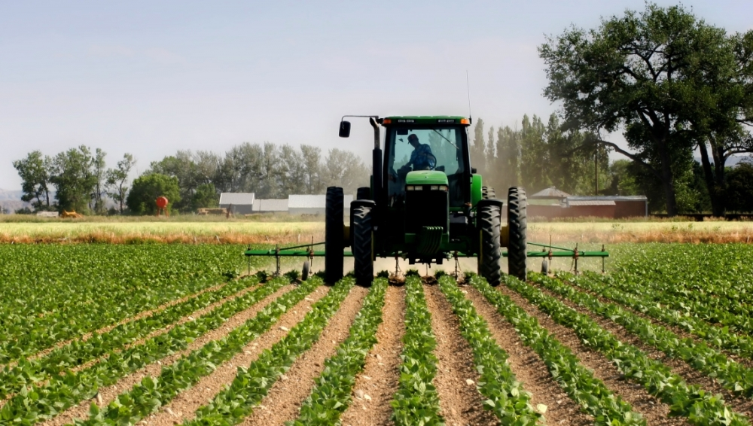
20
Citizens Budget Execution Report 2025
ECONOMIC AFFAIRS
Key achievements in:
Agriculture and Rural Development
The budget allocation to Supporting Measures increased from 4.4 billion LEK to 6.4 billion LEK during 2025. 15,373 farmers benefited from the national supporting measures. 50,062 farmers benefited from the fuel subsidy scheme and 200 grantees for investments. Albanian businesses and products were promoted in 11 national and international activities. 302 new vineyard units and 12,551 olive units have been registered. 105,769 inspections were conducted on the risk management of food safety. | Contracts have been completed to strengthen the laboratory capacities of the Institute of Food Safety and Veterinary (ISUV) in the areas of food safety, animal health, and plant health, as well as the reconstruction of the offices of the Regional Directorate of Veterinary and Plant Protection in Vlorë (DRVMB Vlorë). Key projects in drainage and irrigation infrastructure have been implemented, including the rehabilitation of the Bllacë reservoir, the provision of excavator equipment, and flood protection interventions along the Shkumbin, Osum, and Erzen rivers. The electronic reporting system for fishing activities (ERS) has been implemented.

Slide 21
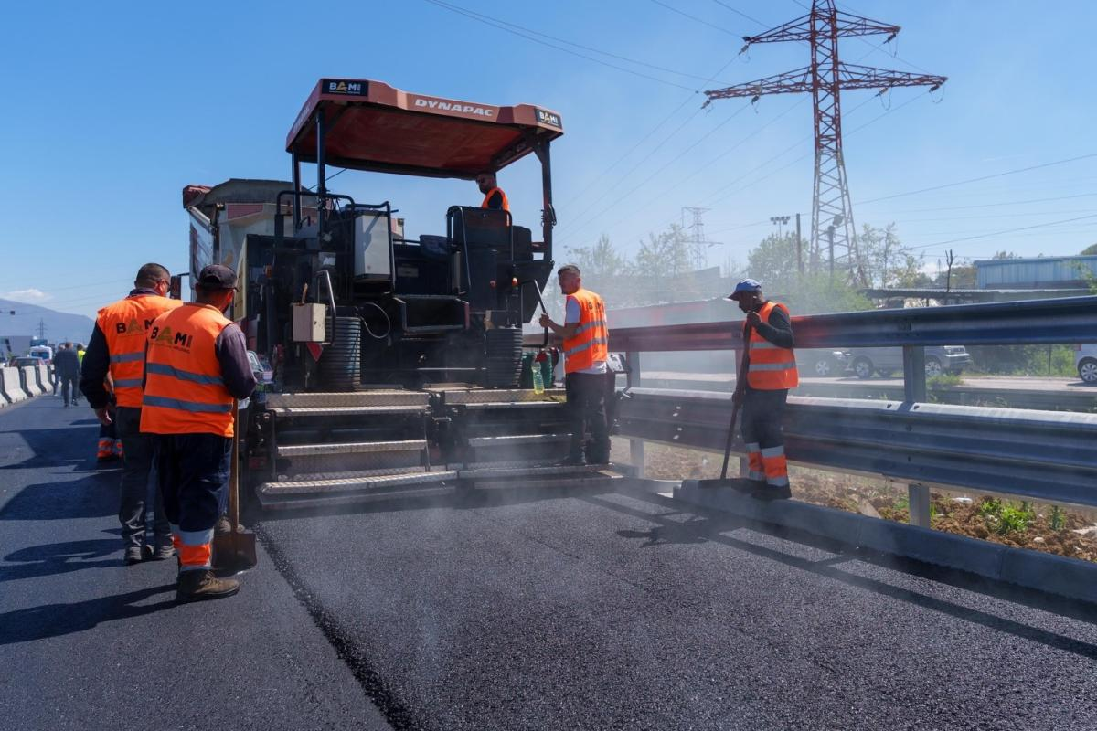
21
Citizens Budget Execution Report 2025
ECONOMIC AFFAIRS
Planned expenditure:
102.4 billion LEK
Actual expenditure:
112.2 billion LEK
or 4.23% of GDP
Budget execution rate:
109.5%
Increase as compared to 2024:
25.3%
3,522 km of roads across Albania have been maintained. Drinking water has been supplied on average for 18 hours per day. 1.7 billion LEK were spent with the aim of creating and supporting the energy sector for sustainable development of the economy through guaranteeing and supplying secure energy sources. The use of the renewable energy increased by 40%. 488,207 linear metre of construction and reconstruction of water supply network was completed. | Several road construction and improvement projects have been completed or are currently under implementation: Outer Ring Road of Tirana , Shqiponja Square–New Boulevard–Shkozë, Bridges over Tirana river, Widening of Elbasan–Qafë Thanë corridor, Maliq–Lozhan i Ri–Strelcë axis, Ura e Cerenecit–Peshkopi road, Qafa e Buallit–Martanesh road. Key investment projects in the water supply and sewerage sector have been financed, including: Water supply in coastal and strategic areas such as Himarë, Lezhë and Divjakë, Reconstruction and extension of the water supply networks of Novoselë, Kamëz, Ballsh and Mallakastër, Construction of the transmission lines and sewerage treatment plants in Drimadhes, Dhërmi and other areas of development importance.
Key achievements in:
Infrastructure and Energy

Slide 22


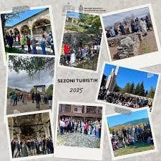
22
Citizens Budget Execution Report 2025
ECONOMIC AFFAIRS
Key achievements in:
Support to Economic Development
163 thousand businesses were served according to the Business Registration system and about 13 thousand businesses according to the License Registration system. 57 events were organised by the Albanian Investment Development Agency to promote Albania as a destination for investments. 105 meetings were held focused on the enhancement of the business climate. 81 benefited grants from Startup and Innovations fund. | 45 projects benefited from the grants scheme of the Albanian Investment Development Agency to support SMEs.
Key achievements in:
TOURISM
  The municipalities of Durrës, Kavajë, Rrogozhinë, Vlorë, Himarë, Lezhë, Fier, Sarandë and Shkodër were supported to clean the beaches.
  1 593 monitoring activities were carried out along the coastline.
  Albania was promoted as touristic destination in "IT Berlin Tourism Fair“.
  4 million tourists entered the protected nature areas.
  27 tourism development projects were financed.
  The development of tourism infrastructure, with a particular emphasis on water-based tourism, has been completed through the Eko-Park Ulza project.

Slide 23
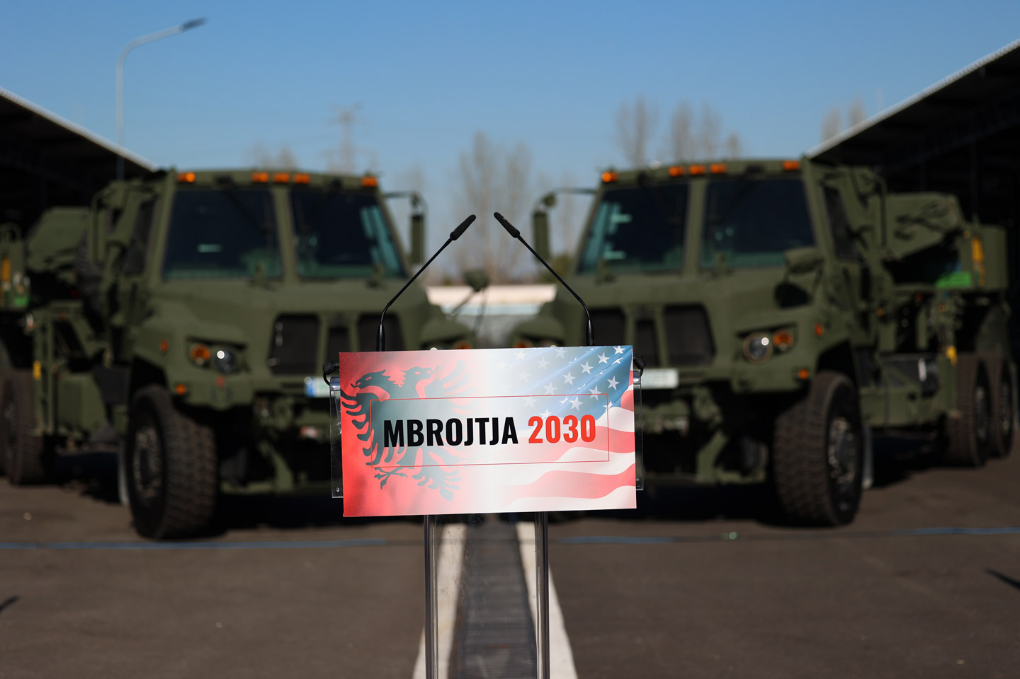
23
Citizens Budget Execution Report 2025
DEFENSE
Planned expenditure:
37.5 billion LEK
Actual expenditure:
27 billion LEK
or 1.02% of GDP
Budget execution rate:
72.1%
Increase as compared to 2024:
25.8%
Key achievements: 2,657 land forces personnel, 699 air forces personnel, 707 naval forces personnel were kept on standby. 383 military contingents participated in peacekeeping missions abroad. Logistical support for the Armed Forces of the Republic of Albania was provided through a staff of 1,242 persons. Over 73 thousand outpatients and emergency patients were treated at the Military Medical Unit of the Trauma Hospital. | 121 families were assisted when their homes were damaged by natural disasters. A multifunctional facility for the accommodation of the Armed Forces command and staff has been constructed. Equipment has been procured to strengthen security and ensure the protection of information within the facilities and premises of the armed forces. Significant projects have been financed to equip the armed forces with the necessary weaponry, ammunition, and operational equipment.

Slide 24
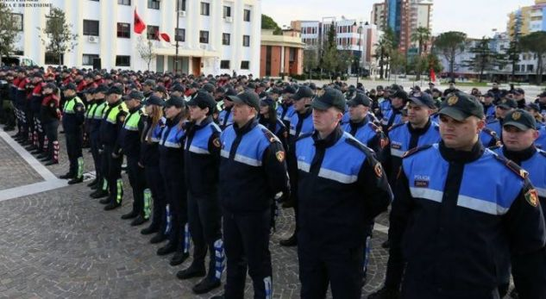
24
Citizens Budget Execution Report 2025
PUBLIC ORDER AND SAFETY UBLIKE
Planned expenditure:
54.7 billion LEK
Actual expenditure:
51.8 billion LEK
or 1.95% of GDP
Budget execution rate:
94.7%
Increase as compared to 2024:
7.1%
Key achievements: Services were provided to 4.370 male convicts, 102 female convicts and 20 juvenile convicts. 477 sick convicts were treated with health services. 8,760 men, 698 women and 312 juvenile offenders were effectively supervised during probation service. 232 offenders benefited from services of their reintegration in the society. Free legal aid was provided to 5,300 individuals of whom 57.7% are women and girls. 17,608 expert acts classified as; forensic, toxicological-legal, biological-legal and psychiatric-legal were carried out, in accordance with European standards. The distribution scheme of the Special Compensation Fund was implemented for 96 owners. 3,527 owners affected by the informal constructions were compensated and paid. 38,195 police operations and investigation were conducted. | The reconstruction of the facilities of the Institute of Forensic Medicine has been completed. State Police buildings were constructed and reconstructed and technological systems (TIMS) & infrastructure were improved to increase the security and efficiency of police services. Financing continued for investment projects within the penitentiary system, with the objective of enhancing living conditions for inmates and modernizing correctional infrastructure. The reconstruction of the Kukës Penitentiary Institution (IEVP Kukës) was financed.

Slide 25
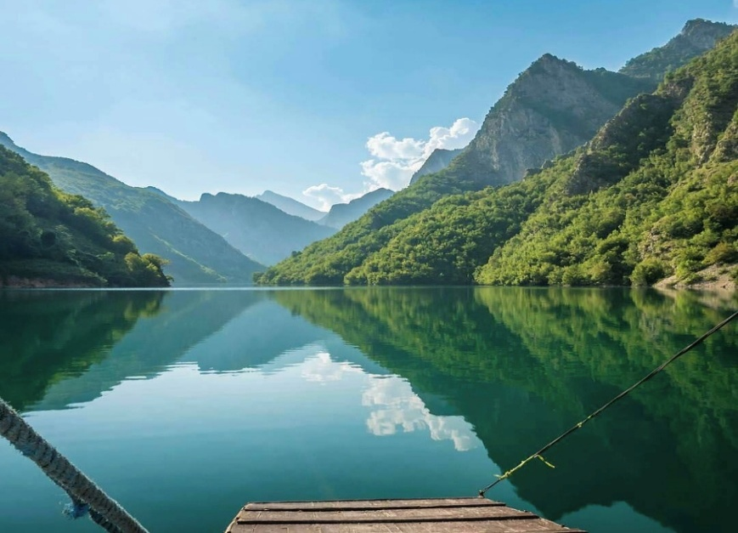
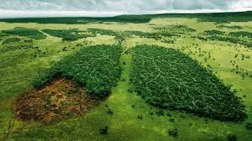
25
Citizens Budget Execution Report 2025
ENVIRONMEMTAL PROTECTION
Planned expenditure:
7.8 billion LEK
Actual expenditure:
8.6 billion LEK
or 0.33% of GDP
Budget execution rate:
110.8%
Incresase as compared to 2024:
9.3%
Strategic projects have been developed and implemented, including the establishment of a multifunctional center in the Vjosa Valley. SANEX Chapter 27-SIDA programme was implemented to improve and align environmental standards in the areas of water management and environmental protection. | Key achievements: 644 inspections were carried out to prevent the deterioration and overuse of water resources; water, air and soil pollution to improve quality of the environment, air, nature protection and biodiversity. 8340 monitoring reports on the environment were prepared. Plans were drawn for sustainable management of the ecosystems, promotion of a green economy, coordination at the local and central level.

Slide 26
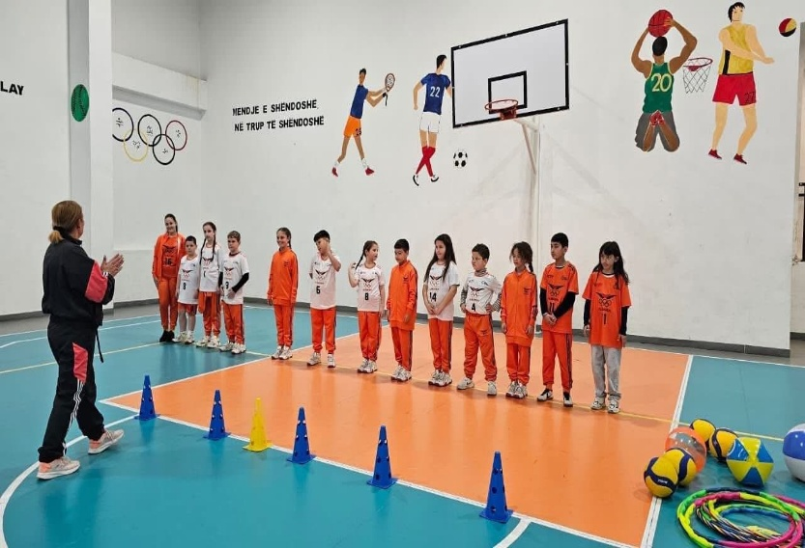
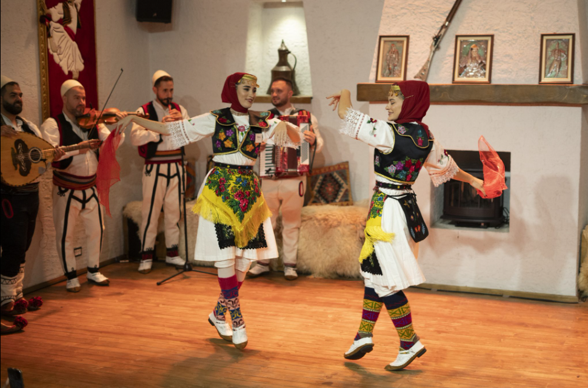
26
Citizens Budget Execution Report 2025
RECREATION, CULTURE AND RELIGION
Planned expenditure :
11.8 billion LEK
Actual expenditure:
13.2 billion LEK
or 0.5% of GDP
Budget execution rate:
111.6%
Increase as compared to 2024:
7.1%
Key achievements: 895 performances, premieres and artistic activities were supported in the choreographic, national folklore, classical, contemporary and circus genres. Projects in the field of arts and culture were completed, including the revitalization of the facilities within the “Shefqet Doda” palace of culture, the reconstruction of the “Pjetër Budi” Art Gallery and library in Mat, as well as improvement works and interventions in the “Artan Cuku” palace of culture and “Migjeni” theater. Projects were implemented in the fields of cultural heritage preservation and youth development, including the restoration of the Berat Castle, “Marubi” Museum and the Archaeological Museum of Korça, as well as the development of youth infrastructure through digital centers, innovation hubs, and the reconstruction of youth centers. | 269 projects and programmes supported by the independent scheme. 150 national and international sports activities in all disciplines, based on the sports calendar. 480 students participated in the National Internship Program. 190 children theatre performances were made.

Slide 27
27
Citizens Budget Execution Report 2025
LOCAL BUDGET
Total revenue:
44.8 billion LEK or 2% of GDP
Transfer from state budget:
44.6 billion LEK
Total expenditure:
87.8 billion LEK
or 3% of GDP
In 2025, municipalities across Albania made great progress in managing their own finances. The stable increase in local revenues shows that local governments are becoming more financially stable and capable of providing public services. Revenues from property taxes, local taxes, and fees for municipal services were higher than expected and the previous year. This is a strong sign that local governments are improving how they collect money and are becoming more self-reliant — a key step toward delivering better services to citizens.
Property tax is a very important source of revenues in local budgets, on which the municipalities may develop local policies and have complete discretion over its use.
In 2025, another step was made on the reform in property tax focused on developing a better methodology for establishing a property tax based on the value of the property as well as the creation of the fiscal cadaster for the administration of the property tax.
Revenues Local Government (billion LEK)
Local government expenditures for 2025 reached 87.8 billion LEK compared to 74.4 billion LEK spent in the previous year. This shows an increase of 18% compared to 2024, meaning more is spent on services delivered to citizens.
The level of arrears was reduced 326 million LEK or decreased by 10% in 2025 as compared to 2024, which is a remarkable achievement with regard to the management and improvement of the financial situation of the local government units.

Slide 28
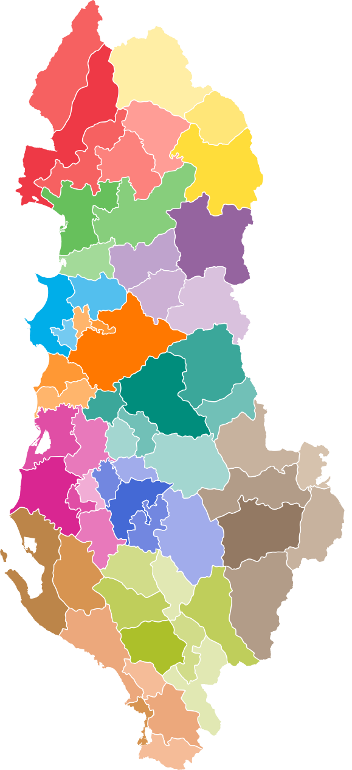
28
Citizens Budget Execution Report 2025
LOCAL BUDGET
Expenditures Local Government (billion LEK)
Local finances are an important pillar of the decentralization agenda, creating opportunities for local governments to have more financial resources, so that they can carry out their functions and competencies efficiently and sustainably.
To help municipalities manage public money more effectively — and to move closer to European Union standards — several important reforms are underway:
Enhanced Budget Procedures. Local governments are improving how they plan, spend, and report their budgets. These changes are helping to make local finances more transparent and aligned with EU practices.
Focus on Results. New performance management information is introduced in the budget to show how the budget affects public services. This helps local governments, civil society, and citizens better understand how money is being used and what results it delivers.
PFM at local level. Strengthening the rules and procedures for managing public finances at the local level by ensuring more fiscal discipline in managing financial difficulties.

Slide 29
29
Citizens Budget Execution Report 2025
REFORMS IN PUBLIC FINANCIAL MANAGEMENT
T
The government is working intensively to improve how public money is collected, spent and monitored – to bring Albania closer to European Union (EU) standards. Here are some of the key steps being taken
A New Fiscal Council. An independent Fiscal Council is being set up to advise on fiscal policy and government spending and ensure that financial rules are followed.
Fairer Tax Collection. The Tax Administration is taking action to reduce the informal economy, so that everyone — individuals and businesses — pays their fair share of taxes.
Better Online Tax Services. Tax services are being improved through the e-Albania platform, making it easier for citizens and businesses to file their taxes online.
Faster Customs Procedures. Customs systems are being updated to meet EU standards, helping goods move more quickly and smoothly across borders.
Fairer Public Procurement. New rules and systems are being introduced to make public procurement more transparent and competitive, with improved complaint handling.
Fighting Fraud and Corruption. Risk and integrity systems are being strengthened to reduce the chances of fraud and corruption in public finances.
Managing EU Funds Responsibly. EU funds are an important part of the national budget. Systems for managing these funds are being improved to meet EU standards.
Stronger Public Audits. The Supreme Audit Institution is modernising how it operates and communicates to better inform Parliament and the public about how money is being used.
Improving Property Tax Collection. The government is updating the property tax system to ensure that all property owners and users contribute fairly.
More Public Involvement. Citizens will have more opportunities to take part in the budget process. Budget documents and reports will be easier to access and understand.

Slide 30


